Slide 1

Superstore Sales Performance Analysis
Prep by: Jalen Bullard
Date: Jan 2026
Data Analyst Project

Slide 2
Business Objective
Business Objective
—---------
Analyze the sales and profit trends over time, across different regions, and among various product categories.
Identify regions of exceptional performance and areas requiring improvement.
Offer data-informed recommendations to enhance profitability.

Slide 3
Business Objective
Key Insights Summary
—---------
The overall sales trend indicates consistent growth, with distinct seasonal surges at year-end.
The Western region consistently generates the highest sales revenue.
Technology remains the most lucrative category, whereas Furniture underperforms.
Profitability differs considerably across categories despite comparable sales volumes.

Slide 4
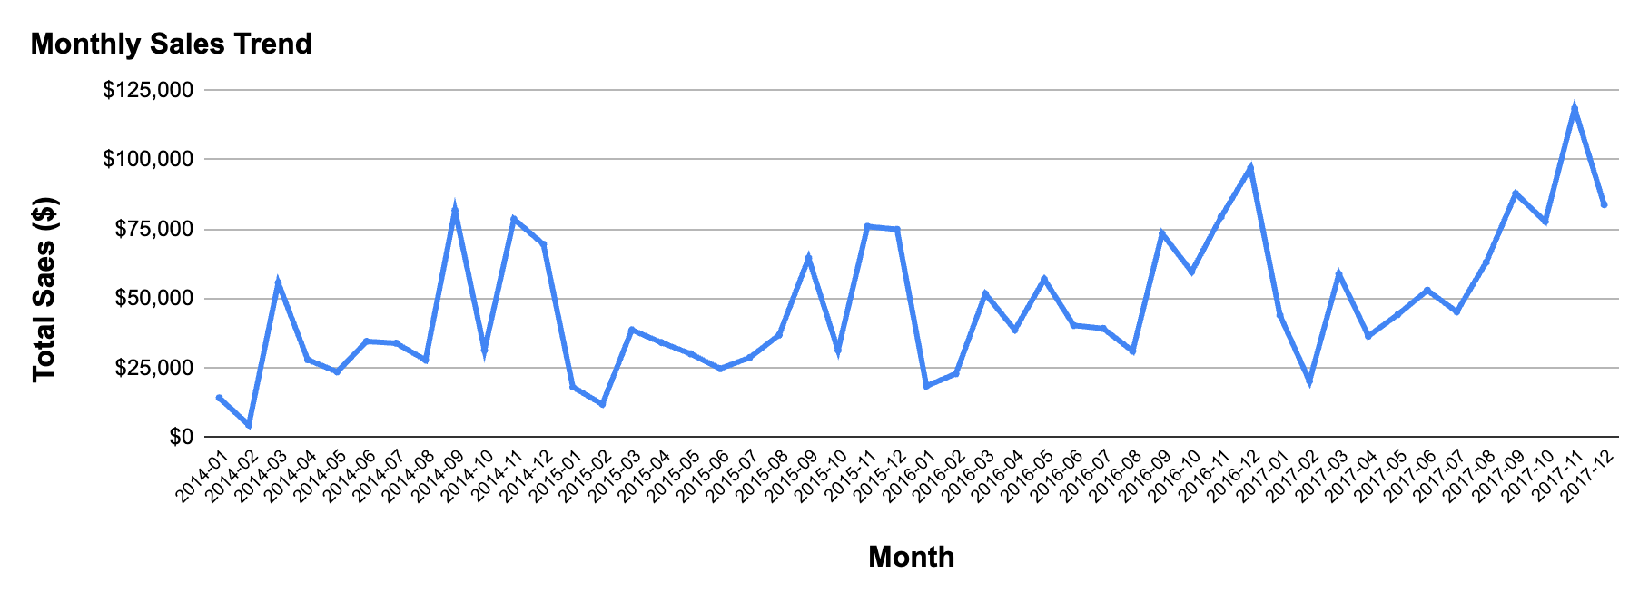
Sales Show Long-Term Growth With Clear Year-End Seasonality
Sales demonstrate a sustained upward trend over the long term.
Notable month-to-month fluctuations indicate the presence of seasonality.
Significant increases in sales typically occur at the conclusion of each year.

Slide 5
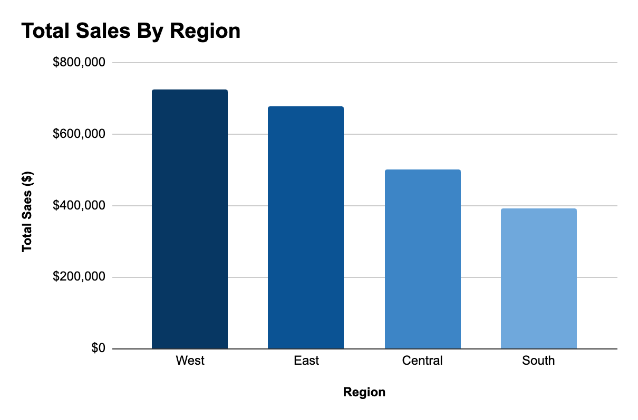
West and East Drive the Majority of Sales While South Underperforms
The western region reports the greatest overall sales.
East trails in near proximity
South persistently underperforms in comparison to other regions

Slide 6
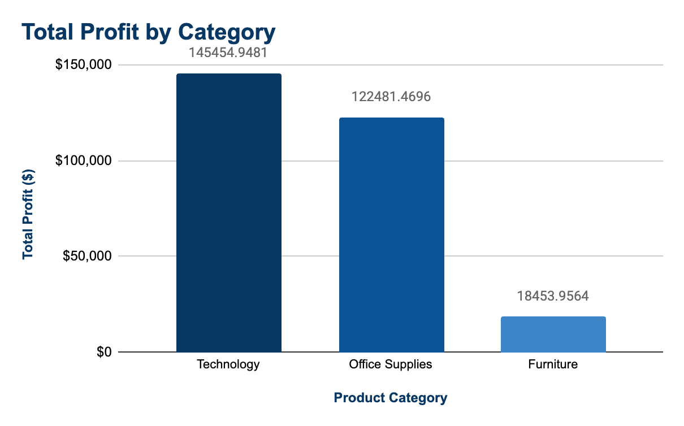
Technology Generates the Most Profit While Furniture Lags Significantly
Technology yields the most significant aggregate profit.
Office Supplies maintains consistent yet modest profitability.
Furniture represents the least profitable category.

Slide 7
Business Objective
Recommendations
—---------
Enhance investment and marketing efforts in Technology products to optimize profitability.
Analyze the cost structure and pricing strategy for the Furniture category.
Formulate targeted development strategies for the Southern region
Perform a more comprehensive analysis of seasonal drivers to enhance inventory planning.

Slide 8
Thank You!

